Slide 1


KJEI’s
K J College of Engineering & Management Research, Pune
Department of Computer Engineering
Savitribai Phule Pune University
Academic Year: 2025-2026
Presentation
On
A Web Based Smart CNG Reservation System
Presented By Guided By
Mr. Prathmesh Gaikwad [B400720164] Prof. Mayuri Vengurlekar
Mr. Shreyash Jangam [B400720186]
Ms. Kadambari Kale [B400720188]
Mr. Sujit Kale [B400720190]

Slide 2
AGENDA
Contents
1
Introduction
8
Problem Statement
Technology Stack
2
9
Implementation
3
Objective
10
Testing
4
11
Result & Output
Literature Review
5
Proposed Solution
12
Future Scope
6
System Architecture
13
Conclusion
7
Module Description
14
References

Slide 3
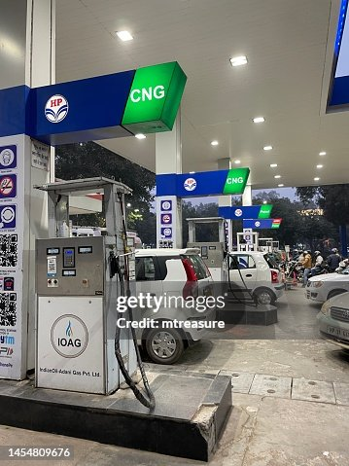
AGENDA
Introduction
The use of CNG vehicles is increasing due to their low cost and eco-friendly nature.
Long queues at CNG stations cause delays and inconvenience for customers.
The Smart CNG Reservation System allows users to book CNG filling slots online in advance.
It helps reduce waiting time, improve queue management, and provide a faster and more convenient refueling experience.

Slide 4
AGENDA
Problem Statement
The increasing number of CNG vehicles has resulted in long queues and overcrowding at CNG stations.
Users cannot check real-time slot availability or waiting time before visiting a station.
Manual queue management leads to delays and inconvenience.
A smart digital reservation system is needed to enable online slot booking and improve queue management.

Slide 5
AGENDA
Objective
Develop an online CNG booking system.
Reduce customer waiting time.
Improve queue management.
Provide real-time slot availability.
Enable secure login and booking.
Generate booking confirmations.
Allow station administrators to manage reservations.

Slide 6
AGENDA
Literature Review / Existing Systems
Sr. No. | Paper/System | Technology Used | Advantages | Limitations
1 | Smart Fuel Queue Management System (A. Kumar et al., 2022) | Queue Management | Reduces waiting time | No online slot booking
2 | Web-Based Reservation System (S. Patil et al., 2021) | PHP, MySQL | Easy online booking | Limited scalability
3 | IoT-Based Smart Fuel Monitoring (R. Sharma et al., 2023) | IoT Sensors | Real-time fuel monitoring | Requires additional hardware
4 | Digital Queue Management System (M. Khan et al., 2021) | Queue Management | Better queue handling | No reservation feature
5 | Queue Optimization in Fuel Stations (P. Verma et al., 2022) | Smart Scheduling | Improves station efficiency | No user booking module

Slide 7
Sr. No. | Paper/System | Technology Used | Advantages | Limitations
6 | Cloud-Based Reservation System (J. Lee et al., 2022) | Cloud Computing | Centralized management | Security and privacy concerns
7 | Online Booking for Smart Services (S. Gupta et al., 2023) | Web Technologies | Convenient booking | Not designed for CNG stations
8 | IoT-Based Smart Fuel Monitoring (R. Sharma et al., 2023) | IoT Sensors | Real-time fuel monitoring | Requires additional hardware
9 | Reservation Database System (T. Roy et al., 2021) | MySQL Database | Efficient data management | Limited real-time updates
10 | Smart Service Web Applications (H. Mehta et al., 2022) | HTML, CSS, JavaScript | User-friendly interface | Limited booking functionality

Slide 8
Literature Review / Existing Systems
How Our Project is Better
✔ Online CNG slot booking
✔ Real-time slot availability
✔ Separate dashboards for User, Seller, and Admin
✔ Easy reservation management
✔ Reduces waiting time and improves queue management

Slide 9
AGENDA
Proposed Solution
The Smart CNG Reservation System provides a web-based platform where:
Users register and log in.
Search nearby CNG stations.
Check slot availability.
Reserve preferred time slots.
Receive booking confirmation.
Admin manages stations and bookings.
Technologies Used
HTML | CSS
JavaScript | JSP
Servlet | Java
MySQL | Apache Tomcat

Slide 10
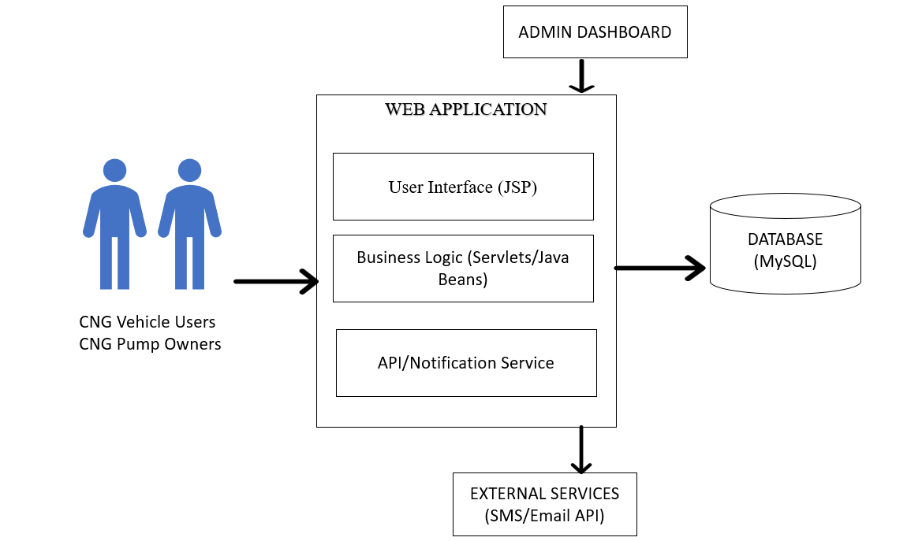
AGENDA
System Architecture

Slide 11
AGENDA
System Architecture
Users (CNG Vehicle Owners & Pump Owners) access the system through the web application.
The User Interface (JSP) allows users to register, log in, and book CNG slots.
The Business Logic (Java Servlets/Beans) processes user requests, validates data, and manages bookings.
All user and booking information is stored in the MySQL database.
The Admin Dashboard allows the administrator to manage users, CNG stations, and reservations.
The API/Notification Service sends booking confirmations and updates via SMS or Email.

Slide 12
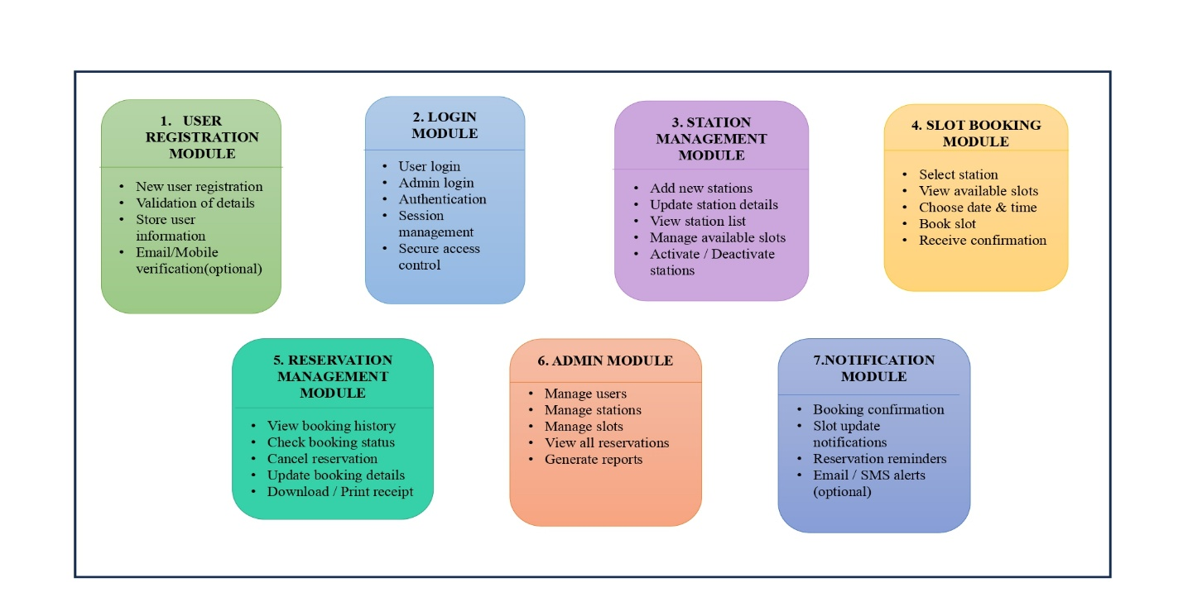
AGENDA
Module Description

Slide 13
AGENDA
Module Description
User Registration Module: Allows new users to register and stores their details securely after validation.
Login Module: Authenticates users and administrators and provides secure access to the system.
Station Management Module: Enables the admin to add, update, and manage CNG stations and available slots.
Slot Booking Module: Allows users to select a station, choose a preferred date and time, and book a slot.
Reservation Management Module: Users can view booking history, check reservation status, update, or cancel bookings.
Admin Module: Admin manages users, stations, reservations, and generates reports.
Notification Module: Sends booking confirmations, slot updates, and reminder notifications via SMS or email.

Slide 14
AGENDA
Technology Stack
Component | Technology
Frontend | HTML, CSS, JavaScript
Backend | Java, JSP, Servlet
Database | MySQL
Server | Apache Tomcat
IDE | Eclipse
Version Control | Git
Browser | Chrome

Slide 15
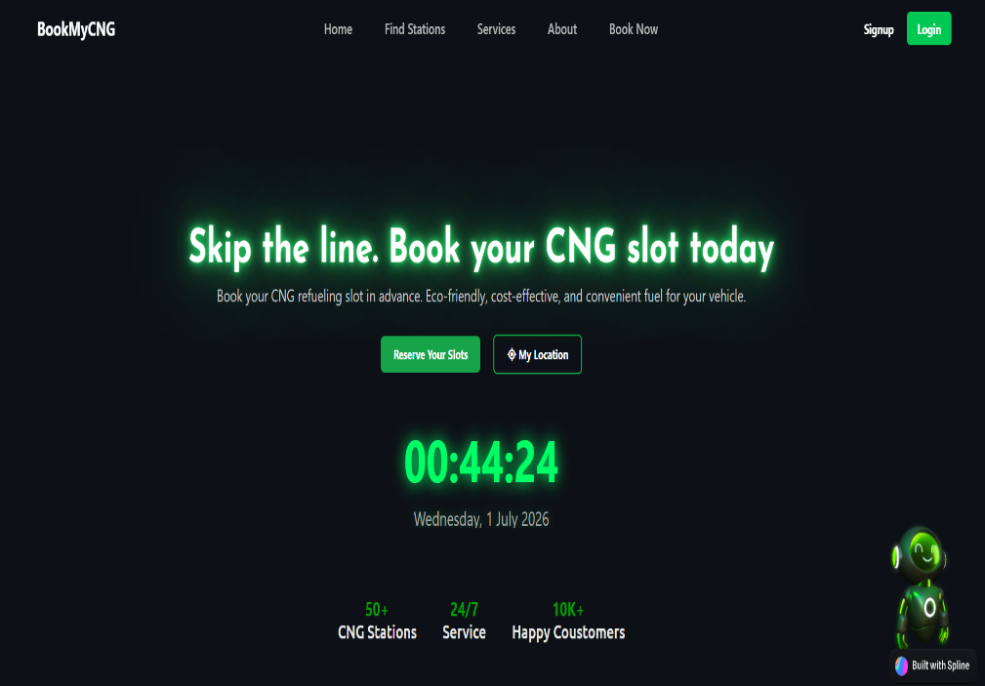
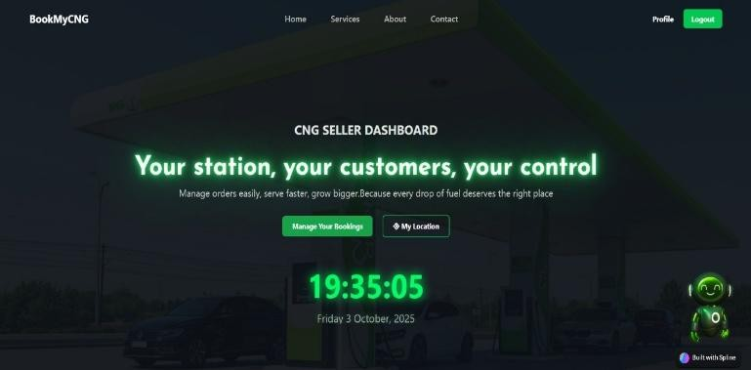
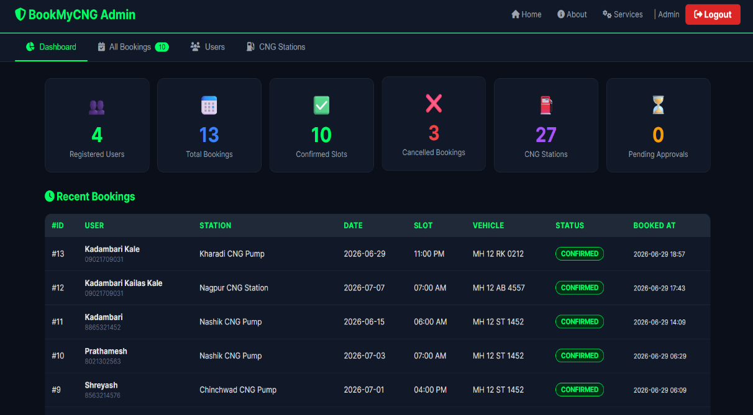
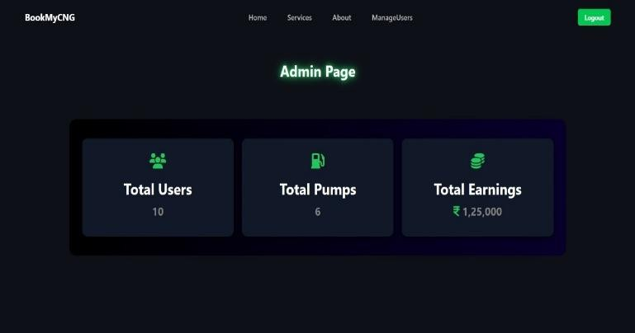
AGENDA
Implementation

Slide 16
AGENDA
Implementation
The Smart CNG Reservation System is implemented as a web application using JSP, Servlets, Java, MySQL, HTML, CSS, and JavaScript. The system provides separate interfaces for users, CNG station owners, and administrators.
Key Features:
User Dashboard: Users can view stations, book CNG slots, and manage reservations.
CNG Seller Dashboard: Sellers can manage station details, available slots, and customer bookings.
Admin Dashboard: Admin monitors users, bookings, stations, and system activities.

Slide 17
AGENDA
Testing
Testing Type | Description | Status
Unit Testing | Tested individual modules like Login and Booking | ✅ Passed
Integration Testing | Verified interaction between modules and database | ✅ Passed
System Testing | Tested the complete application workflow | ✅ Passed
Tools Used:
Eclipse IDE
Apache Tomcat
MySQL
Google Chrome
Result: All core functionalities worked successfully without major errors.

Slide 18
AGENDA
Result & Output
Result:
Successfully implemented online CNG slot booking.
Reduced manual queue management.
Users can view available slots in real time.
Booking details are securely stored in the database.
Admin can efficiently manage stations and reservations.
Output:
User Registration
Secure Login
Slot Booking
Booking Confirmation
Admin Dashboard

Slide 19
AGENDA
Future Scope
Mobile application (Android/iOS)
Online payment integration
GPS-based station navigation
SMS/Email notifications
AI-based queue prediction

Slide 20
AGENDA
Conclusion
The Smart CNG Reservation System offers a modern digital solution to reduce queues and improve efficiency at CNG stations. By enabling users to pre-book slots and check real-time availability, the system saves time and enhances convenience. It also helps station operators manage operations more effectively through automation and data tracking. Overall, this project promotes smart, sustainable, and efficient fuel management using web-based technology.

Slide 21
AGENDA
References
Research Papers
[1] A. Kumar and R. Singh, “Smart Fuel Queue Management System,” International Journal of Computer Applications, vol. 120, no. 5, pp. 10–15, 2022.
[2] S. Patil and M. Joshi, “Web-Based Reservation System Using PHP and MySQL,” International Journal of Engineering Research and Technology, vol. 8, no. 3, pp. 55–60, 2021.
[3] R. Sharma and P. Kulkarni, “IoT-Based Smart Fuel Monitoring System,” in Proceedings of IEEE International Conference on Smart Computing, Pune, India, 2023, pp. 210–214.
[4] M. Khan and S. Shaikh, “Digital Queue Management System for Public Services,” International Journal of Advanced Computer Science and Applications, vol. 11, no. 4, pp. 88–92, 2021.
[5] P. Verma and S. Kulkarni, “Queue Optimization in Fuel Stations Using Smart Technologies,” International Journal of Advanced Research in Computer Engineering, vol. 9, no. 2, pp. 101–107, 2022.

Slide 22
References
Technical Documentation
Oracle Java Documentation
Apache Tomcat Documentation
MySQL Documentation
Web Resources
W3Schools – HTML, CSS, JavaScript
GeeksforGeeks
Stack Overflow

Slide 23
AGENDA
Thank You
Thank you for your time and attention.
Questions & Discussion

